Slide 1

Travel Advisor
CS 440 Group 20
Hongcheng Wu, Spancer Guo, Jiajie Lin, Zachary Flebbe

Slide 2

Overview
What is Travel Advisor?
Mobile application
Improve the National Park experience
Improve park safety
What are the Key Features?
Park Information
Weather Advisory
Photo Gallery
Navigation System
Emergency Rescue

Slide 3
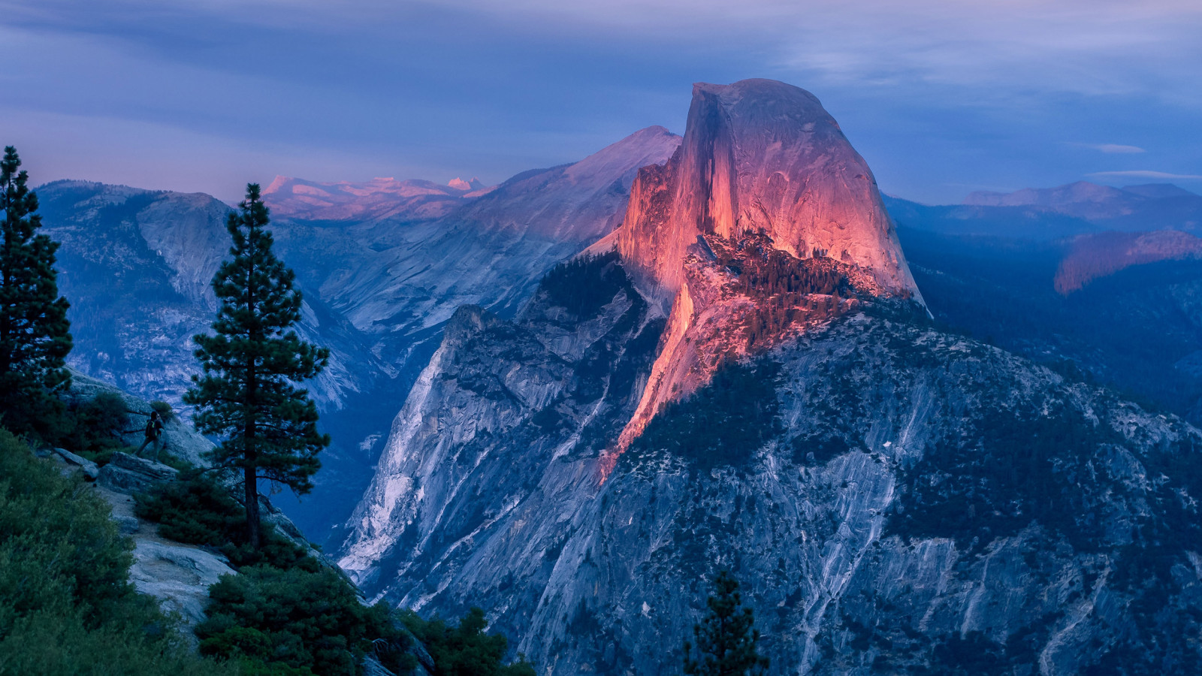
Design Goal
Information accuracy
Navigation system
Rescue team
Opening hour
Application User Interface
Dynamic working environment
Big font size and background color schemes

Slide 4
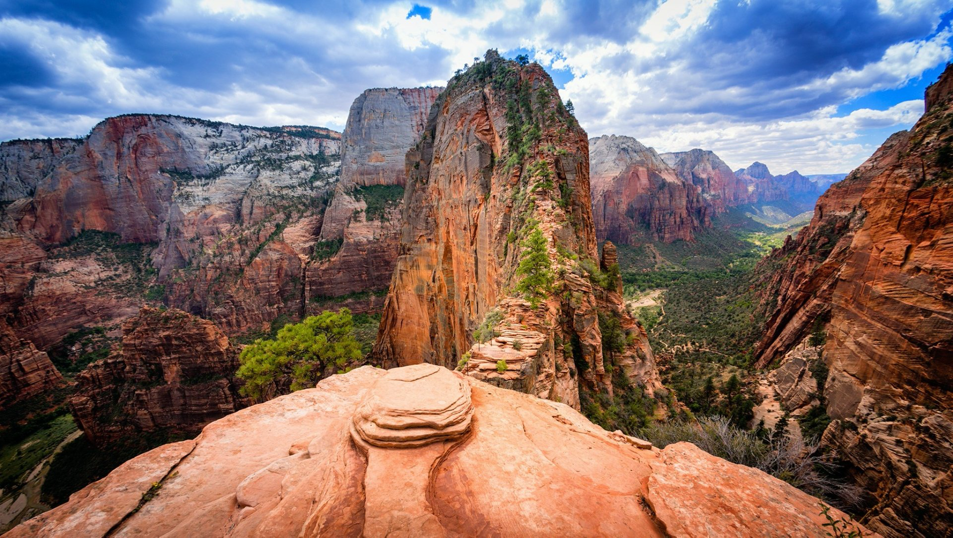
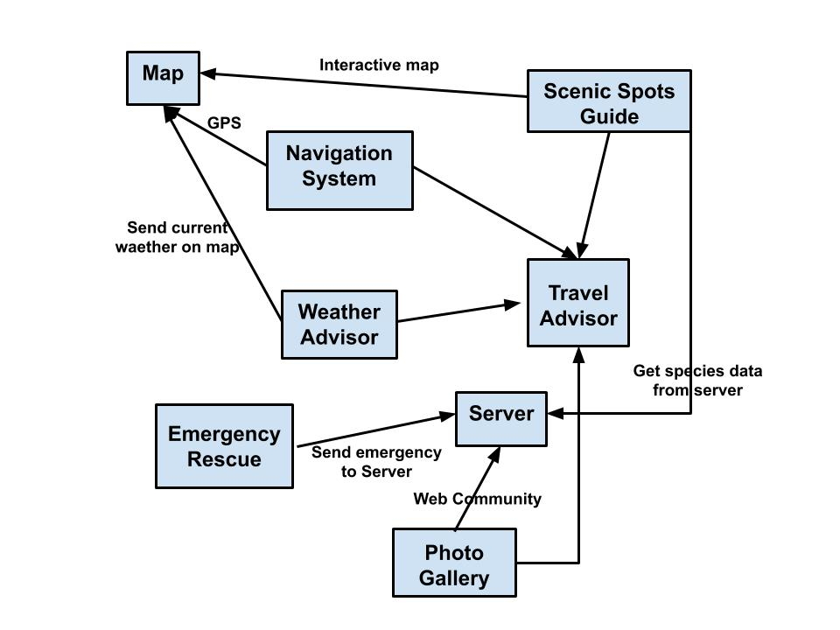
UML Diagram

Slide 5
Other UML

Slide 6

Requirements
Main Classifications:
Functional Requirements
Data Requirements
Performance Requirements
Dependability Requirements
Maintainability and Supportability Requirements
Security Requirements
Usability and Humanity Requirements
Look and Feel Requirements

Slide 7
Requirements continued:
Functional Requirements:
FUNC:-1 : The Emergency Rescue information is fast as possible.
Data Requirements:
DATA-1: Saving species data that users are interested in.
Performance Requirements:
SLR-1: The emergency service algorithm must be instant.
Dependability Requirements:
RR-1: The application shall not fail more than once per day.

Slide 8
Requirements continued:
Maintainability and Supportability Requirements:
MR-1: Maintenance will be available through the help section, email or phone.
Security Requirements:
ACRE-1: Only certain users will need access requirements to be able to change information about the parks and edit information on current employees.
Usability and Humanity Requirements:
EAUS-1: The application should be usable within a training mode.
Look and Feel Requirements:
APRE-1: The product must be able to handle different layouts since the application offers different features(sub system) .

